Slide 1
Fundamentals Of AI & Related Topics
Aravind Daram

Slide 2
Agenda
What is AI – Introduction to AI
AI and its related stack
Relationship of different AI related items
Traditional programming vs AI Models
AI Career paths
Notes:
Image source: https://medium.com/@teztecch/artificial-intelligence-is-the-simulation-of-human-intelligence-processes-by-machines-especially-5ca1b0c828ec

Slide 3
Why AI gained more popularity from 2023?
Because of ChatGPT/Bard(now Gemini)/Llama1/2
Due to Advanced Machine Learning Algorithms.
Growing Foundation Models.
It is just overhyped
Notes:
Image source: https://medium.com/@teztecch/artificial-intelligence-is-the-simulation-of-human-intelligence-processes-by-machines-especially-5ca1b0c828ec

Slide 4
Which of the following statements are true
Artificial Intelligence is simulation of Human Intelligence in the form of programs or machines.
Machine Learning is a Subset of Artificial Intelligence.
Deep Learning is a Subset of Machine Learning.
Generative AI is a subset of Deep Learning
Notes:
Image source: https://medium.com/@teztecch/artificial-intelligence-is-the-simulation-of-human-intelligence-processes-by-machines-especially-5ca1b0c828ec

Slide 5
AI Definition
Artificial Intelligence (AI) is the simulation of human intelligence processes by machines.
These processes include learning, reasoning, and self-correction.
AI can be categorized into narrow AI, which is designed for specific tasks, and general AI, which aims to perform any intellectual task that a human can do.
Notes:
Image source: https://medium.com/@teztecch/artificial-intelligence-is-the-simulation-of-human-intelligence-processes-by-machines-especially-5ca1b0c828ec

Slide 6
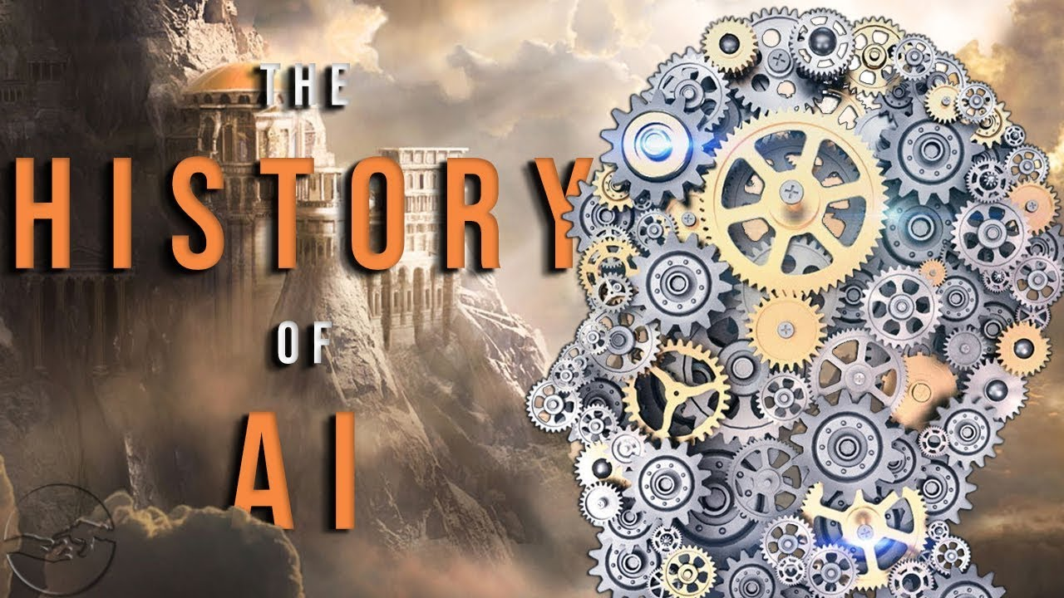
History of AI
The concept of AI dates back to ancient myths and legends about intelligent automatons.
The term "Artificial Intelligence" was officially coined in 1956 at the Dartmouth Conference.
Since then, AI has evolved through various phases, including periods of optimism and challenges known as AI winters.
Notes:
Image source: https://www.youtube.com/watch?v=-qnMLjxJZm0

Slide 7
AI Journey
Traditional AI
(1950s-1980s)
Machine Learning
(1980s-2010s)
Deep Learning
(2010s-2020s)
Generative AI
(2020s- Now)
Notes:
Image source: https://medium.com/@teztecch/artificial-intelligence-is-the-simulation-of-human-intelligence-processes-by-machines-especially-5ca1b0c828ec

Slide 8
Artificial Intelligence (AI)
It is simulation of Human intelligence in the form of programs or machines.
Machine Learning (ML)
It allows the machines to learn based on the previous data and make predictions without explicit Programming. While doing this it will calculate based on optimal performance measure.
Deep Learning (DL)
It use neural network where it learns patterns directly from data through multiple layers. Inspired by neural networks in human brain.
Generative AI (Gen AI)
It is used to create new content. It can be text, images, audio, videos etc.
By learning patterns from existing data and generate new data.
Notes:
Image source: https://medium.com/@teztecch/artificial-intelligence-is-the-simulation-of-human-intelligence-processes-by-machines-especially-5ca1b0c828ec

Slide 9
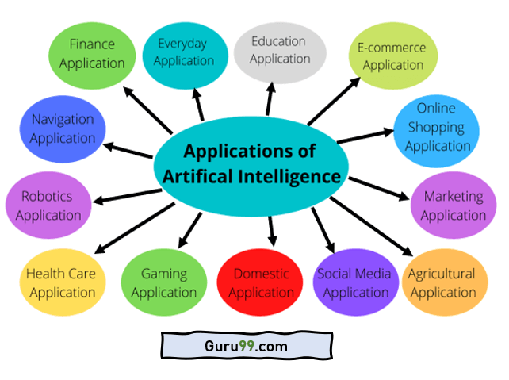
AI in Everyday Life – use cases
AI is increasingly integrated into everyday applications, enhancing user experiences and efficiency.
Examples include virtual assistants like Siri and Alexa, which understand and respond to voice commands.
AI also powers recommendation systems on platforms such as Netflix and Amazon, personalizing content for users.
Notes:
Image source: https://www.guru99.com/artificial-intelligence-applications-examples.html

Slide 10
More – use cases
Fraud Detection
AI models analyze transaction data to detect unusual patterns and identify fraudulent activities in real-time, providing enhanced security for financial institutions and customers.
Autonomous Vehicles
AI enables self-driving cars by processing data from sensors, cameras, and GPS to navigate roads, avoid obstacles, and make driving decisions, aiming to enhance safety and convenience..
Property Valuation
AI models predict property values based on factors like location, market trends, and property features, aiding buyers, sellers, and real estate professionals in making decisions.
Talent Acquisition
AI screens resumes, assesses candidates, and schedules interviews, streamlining the hiring process and helping companies to identify the best talent efficiently.
Notes:
Image source: https://www.guru99.com/artificial-intelligence-applications-examples.html

Slide 11
Puzzle
Input | Output
2 | 6
3 | 24
4 | 60
6 | 210
9 | ?
Notes:
Image source: https://medium.com/@teztecch/artificial-intelligence-is-the-simulation-of-human-intelligence-processes-by-machines-especially-5ca1b0c828ec

Slide 12
Traditional Programming
Logic
a^3-a
Input
Output
A Business use case gets converted into Program and same program is being executed to bring for new input. If any change is needed, then again both business and Programmer need to touch the code.
Notes:
Image source: https://medium.com/@teztecch/artificial-intelligence-is-the-simulation-of-human-intelligence-processes-by-machines-especially-5ca1b0c828ec

Slide 13
Predicting Health Insurance Premium
Age | Premium
0-10 | 1000
11-20 | 1500
21-30 | 2000
31-40 | 2500
45 | ?
55 | ?
Notes:
Image source: https://medium.com/@teztecch/artificial-intelligence-is-the-simulation-of-human-intelligence-processes-by-machines-especially-5ca1b0c828ec

Slide 14
Traditional Programming
Logic/Rules for premium calculation
Input
Output
A Business use case gets converted into Program and same program is being executed to bring for new input. If any change is needed, then again both business and Programmer need to touch the code.
Notes:
Image source: https://medium.com/@teztecch/artificial-intelligence-is-the-simulation-of-human-intelligence-processes-by-machines-especially-5ca1b0c828ec

Slide 15
Predicting Health Insurance Premium - Complex
Age | BMI | Smoking | Children | Region | Premium
25 | 25 | No | 0 | SouthWest | 1000
30 | 29.2 | No | 1 | NorthEast | 1487
35 | 32.3 | Yes | 2 | SouthEast | 1912
40 | 29.9 | Yes | 3 | South | 2359
45 | 31.2 | No | 3 | NorthEast | ?
55 | 35.3 | Yes | 2 | SouthWest | ?
Notes:
Image source: https://medium.com/@teztecch/artificial-intelligence-is-the-simulation-of-human-intelligence-processes-by-machines-especially-5ca1b0c828ec

Slide 16
Predicting Health Insurance Premium – Complex - Solution
In Traditional Program , what are the challenges
Manually Analyze the data or Solution
Rules to be written for Every Factor.
Consolidation of Combined Rules
Update constantly (for any change)
Notes:
Image source: https://medium.com/@teztecch/artificial-intelligence-is-the-simulation-of-human-intelligence-processes-by-machines-especially-5ca1b0c828ec

Slide 17
Machine learning
New Input
Input
&
Output
Examples
ML Algorithm
Model Logic
Output
Notes:
Image source: https://medium.com/@teztecch/artificial-intelligence-is-the-simulation-of-human-intelligence-processes-by-machines-especially-5ca1b0c828ec

Slide 18
Machine learning – understand more deeper
New Input
ML Training
Model
Logic
ML
Inference
Input
&
Output
Output
Notes:
Image source: https://medium.com/@teztecch/artificial-intelligence-is-the-simulation-of-human-intelligence-processes-by-machines-especially-5ca1b0c828ec

Slide 19
Machine Learning is very effecting for Structured Input
ML Model
Structured Input
Output
Notes:
Image source: https://medium.com/@teztecch/artificial-intelligence-is-the-simulation-of-human-intelligence-processes-by-machines-especially-5ca1b0c828ec

Slide 20




How to address Unstructured input data ?
Text
Documents
Audio
files
Video
files
Images
Notes:
Image source: https://medium.com/@teztecch/artificial-intelligence-is-the-simulation-of-human-intelligence-processes-by-machines-especially-5ca1b0c828ec

Slide 21
Deep Learning model can handle unstructured input data without requiring upfront manual preprocessing.
Deep Learning Model
Structured or Unstructured Input
Output
Notes:
Image source: https://medium.com/@teztecch/artificial-intelligence-is-the-simulation-of-human-intelligence-processes-by-machines-especially-5ca1b0c828ec

Slide 22
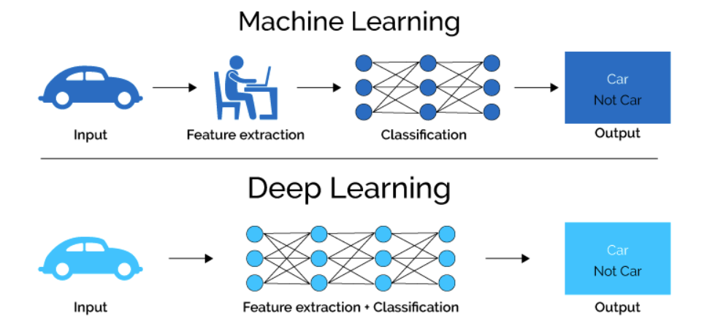
Deep learning
Notes:
Image source: https://qualityhubindia.com/future-of-ai-artificial-intelligence-potential-impacts-industries-healthcare/

Slide 23
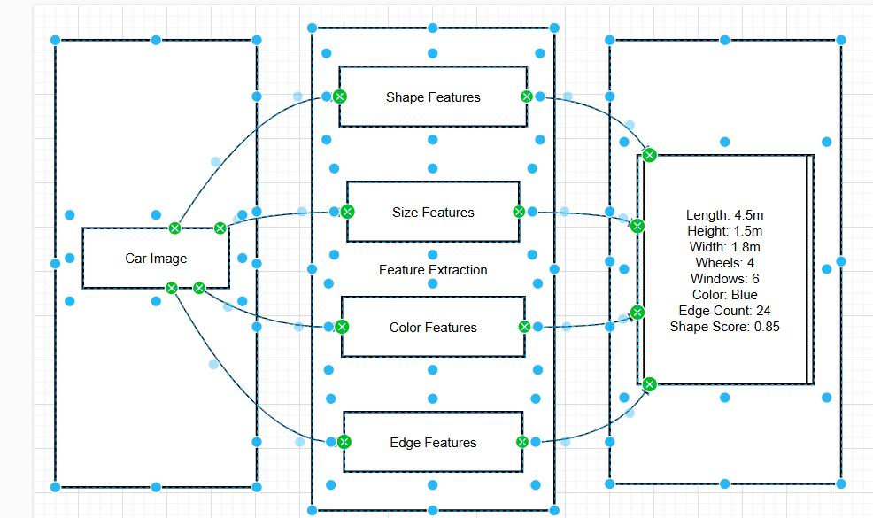
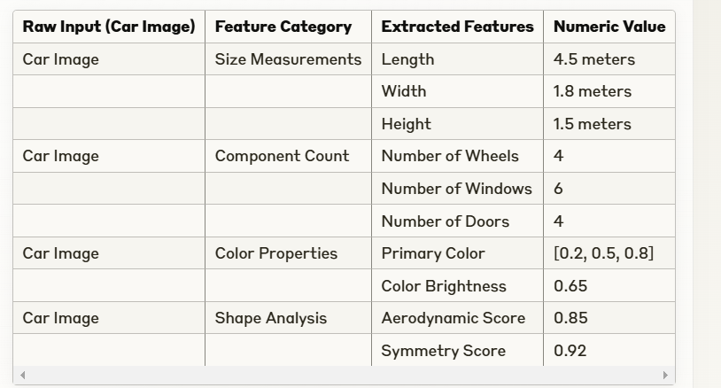
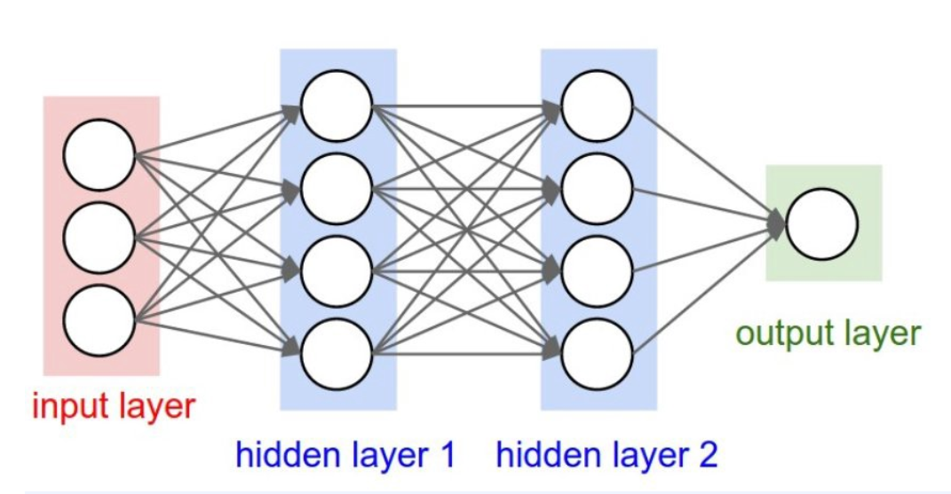
Unstructured data required Manual structuring before it could be processed by Machine learning algorithms.
Manual Extraction
Notes:
Image source: https://qualityhubindia.com/future-of-ai-artificial-intelligence-potential-impacts-industries-healthcare/

Slide 24
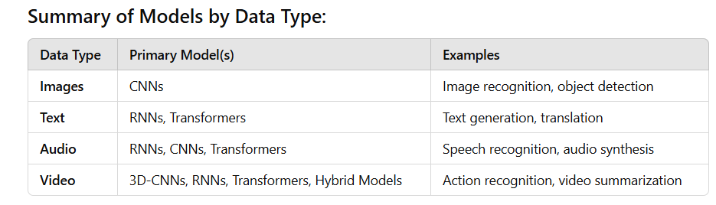


Deep learning Algorithms
Convolutional
Neural Networks
(CNNs)
for images
Recurrent
Neural Networks
(RNNs)
for text
Combinations
of
RNNs and CNNs
for audio/video
Notes:
Image source: https://qualityhubindia.com/future-of-ai-artificial-intelligence-potential-impacts-industries-healthcare/

Slide 25
Automation of Perceptual tasks
Tasks that human do quickly and effortlessly tend to be called as Perceptual tasks.
Example: Seeing, hearing, recognizing, classifying etc..,
Notes:
Image source: https://medium.com/@teztecch/artificial-intelligence-is-the-simulation-of-human-intelligence-processes-by-machines-especially-5ca1b0c828ec

Slide 26

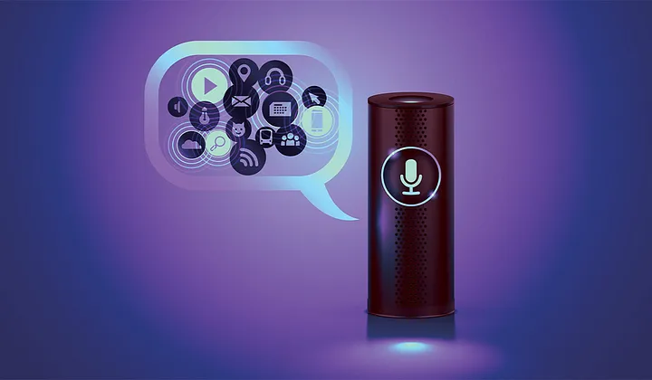
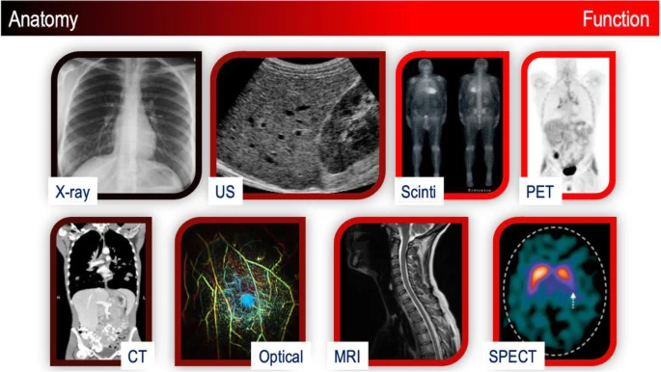
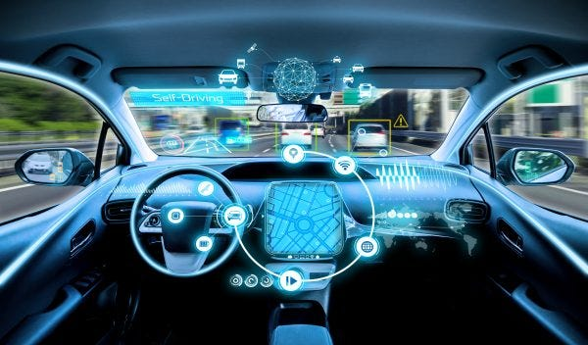
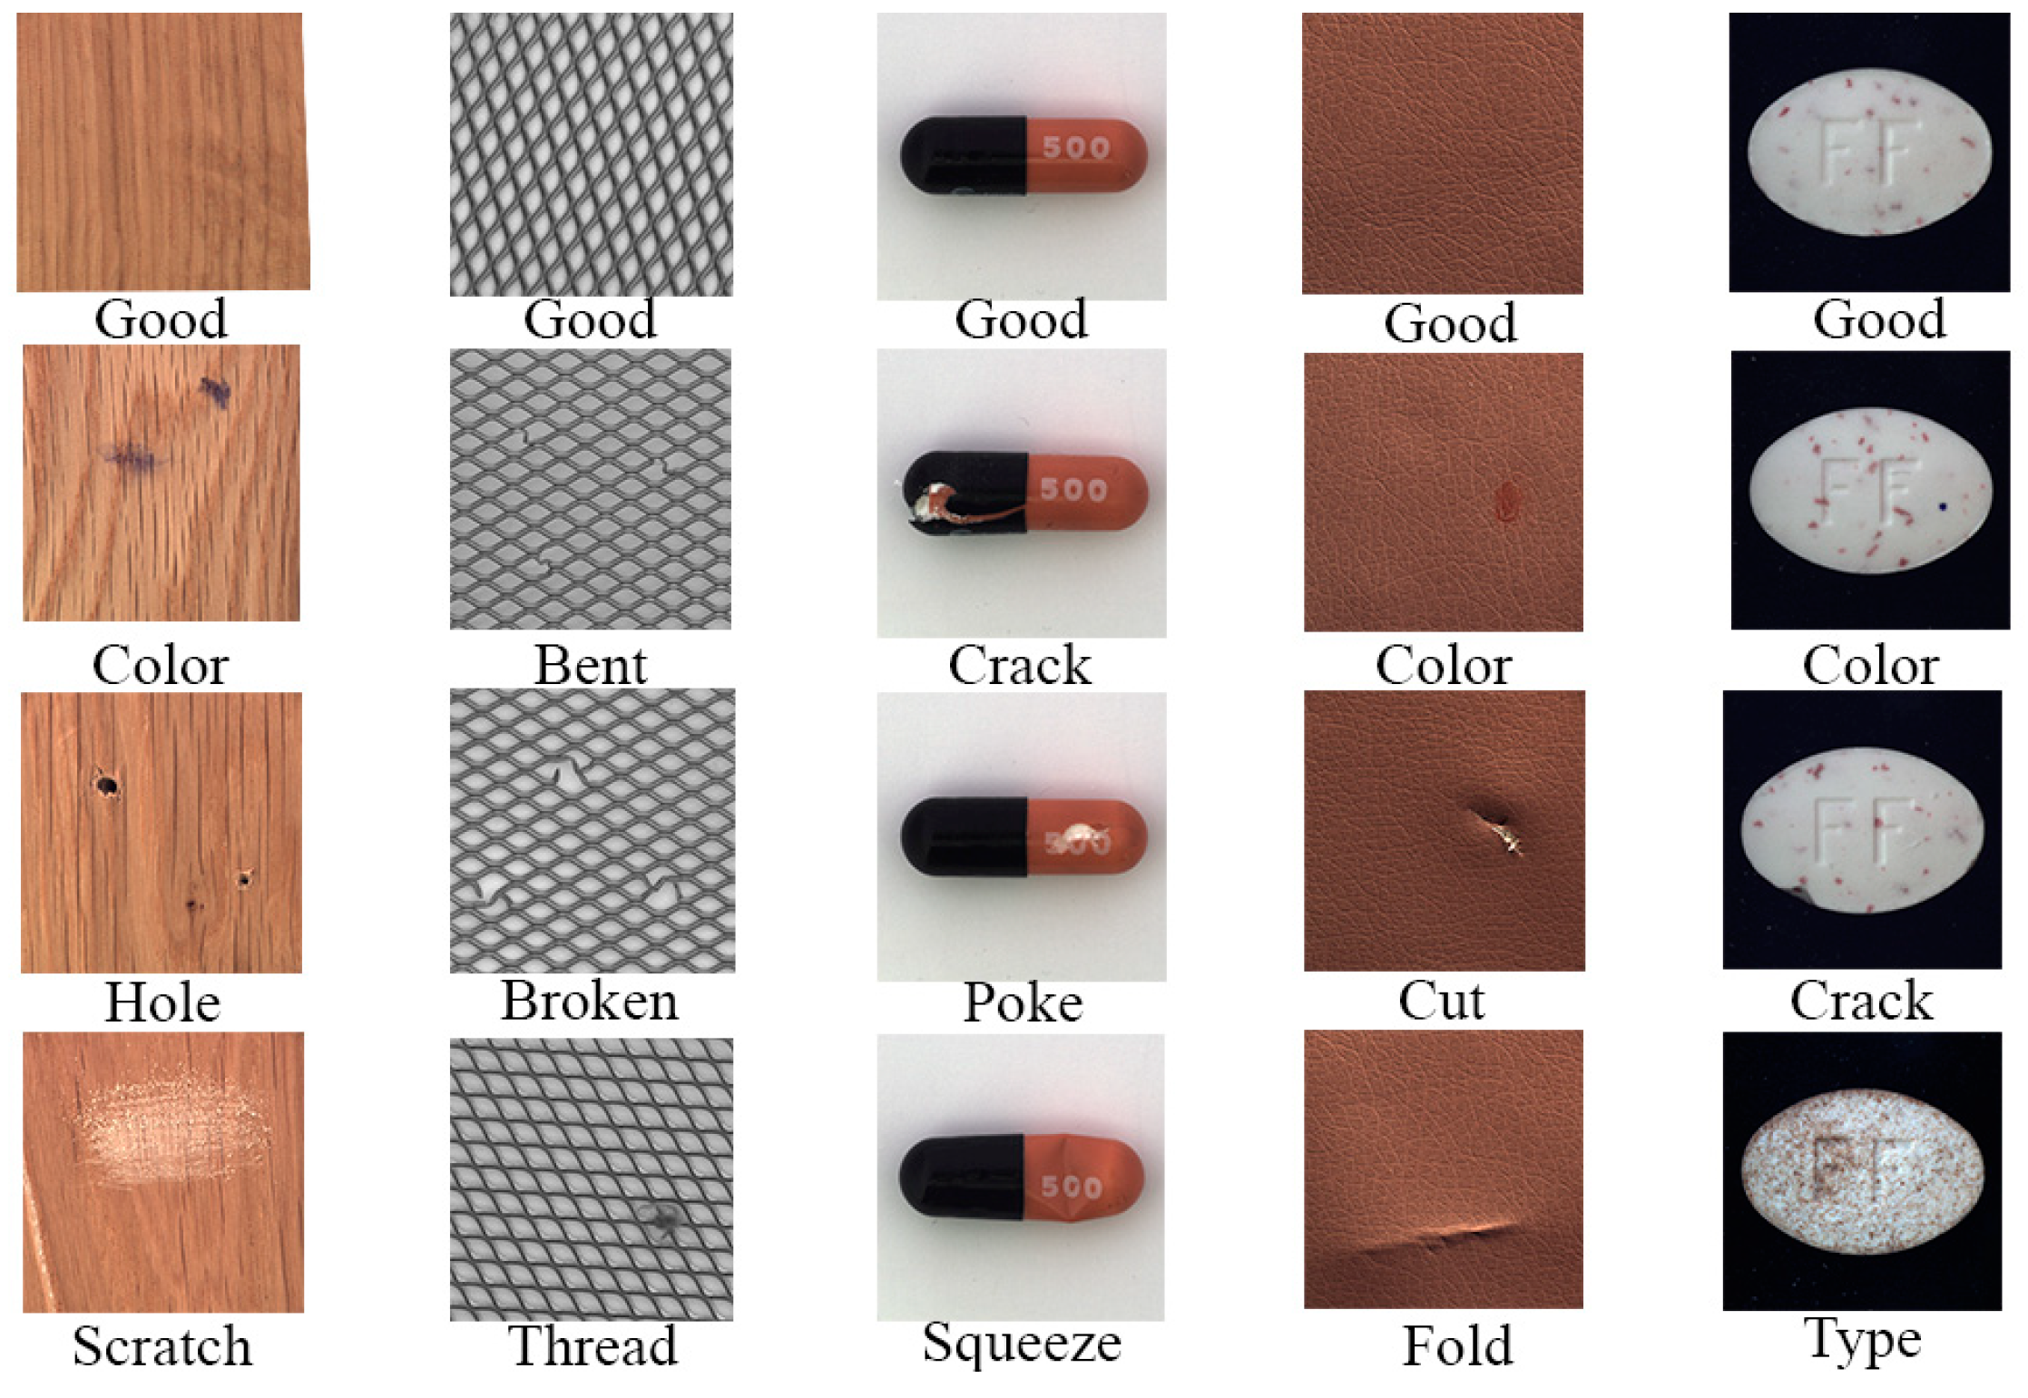
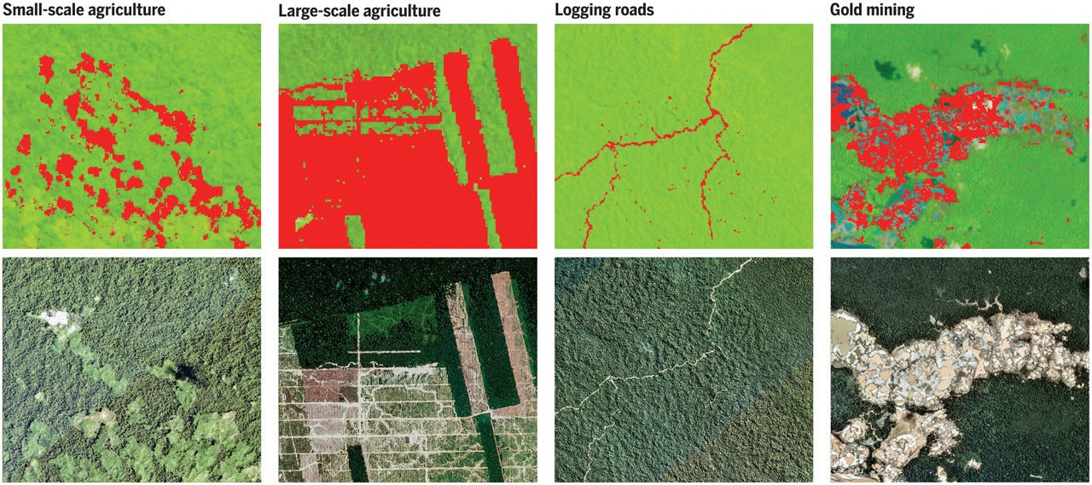
Deep Learning use cases
Image Recognition
Speech Recognition
Medical Imaging
Autonomous Vehicles
Quality Inspection
Environment Monitoring
Notes:
Image source: https://medium.com/@teztecch/artificial-intelligence-is-the-simulation-of-human-intelligence-processes-by-machines-especially-5ca1b0c828ec

Slide 27
Deep leaning can predicting/generate only structured outputs
Examples
Deep Learning Model
Structured or Unstructured Input
Continuous value
Predicting the house price, temperature.
Probabilities of categories
Loan default prediction 0 (no default) , 1 (default)
Notes:
Image source: https://medium.com/@teztecch/artificial-intelligence-is-the-simulation-of-human-intelligence-processes-by-machines-especially-5ca1b0c828ec

Slide 28



Deep leaning could not predict/generate un-structured outputs very well.
Deep Learning Model
Structured or Unstructured Input
Text
Always happens good for good people
Notes:
Image source: https://medium.com/@teztecch/artificial-intelligence-is-the-simulation-of-human-intelligence-processes-by-machines-especially-5ca1b0c828ec

Slide 29
Generative AI – solved the Deep learning gap.
Deep Learning Model
Unstructured Input data
Unstructured output data
Notes:
Image source: https://medium.com/@teztecch/artificial-intelligence-is-the-simulation-of-human-intelligence-processes-by-machines-especially-5ca1b0c828ec

Slide 30
Farmers Bob’s Family tree
Bob’s Family
Mr Bob
Mrs. Bob
Bill
Bobs extended family
Bob Jr.’s

Slide 31
Artificial Intelligence
Machine learning
Deep Learning
Statistical ML
NLP
CNN (convolution)
ANN (Artificial)
RNN (recurrent)
Transformers
Bert
Linear regression
Logistic regression
Decision tree
Random Forest
K-Means Clustering
Rule based
Robotics
Gen AI
LLM
LIM

Slide 32
When to choose Statistical ML vs Deep learning
Statistical ML
Simple Features
Structured Data
Low Data Volume or Small Datasets
Limited Compute Resources
Deep Learning
Complex Features
Unstructured Data(Images, Video, Audio)
High Data Volume or Big Datasets
Enough Compute Resources
Notes:
Image source: https://medium.com/@teztecch/artificial-intelligence-is-the-simulation-of-human-intelligence-processes-by-machines-especially-5ca1b0c828ec

Slide 33
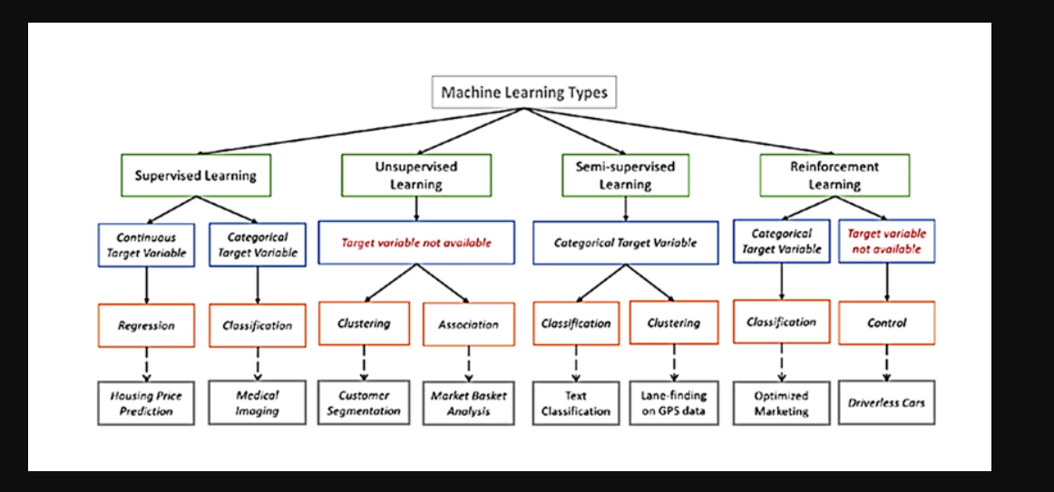
Machine learning Types
Notes:
Image source: https://qualityhubindia.com/future-of-ai-artificial-intelligence-potential-impacts-industries-healthcare/

Slide 34
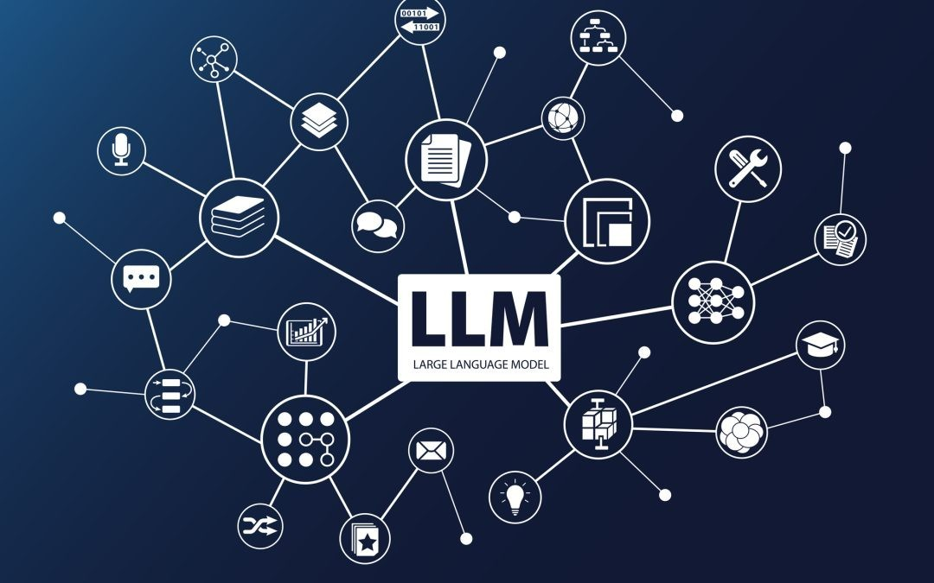
Text based Generative AI is commonly referred as an LLM (Large Language Model)
Notes:
Image source: https://qualityhubindia.com/future-of-ai-artificial-intelligence-potential-impacts-industries-healthcare/

Slide 35
AI related career paths
AI Roles
NonTech
Tech
AI Engineer
Data Scientist
NLP Engineer
CV Engineer
Reinforcement Learning Engineer
Research Scientist
AI Solutions Architect
ML Ops Engineer
AI Security Specialist
Hardware AI Engineer
AI Product Manager
AI Ethicist
AI Sales Executive
AI Project manager
AI UX/UI Designer
AI Policy Specialist/Consultant
AI Governance Manager
AI Content Strategist
AI Program Director
AI Trainer/Operations Specialist
Notes:
Image source: https://medium.com/@teztecch/artificial-intelligence-is-the-simulation-of-human-intelligence-processes-by-machines-especially-5ca1b0c828ec

Slide 36
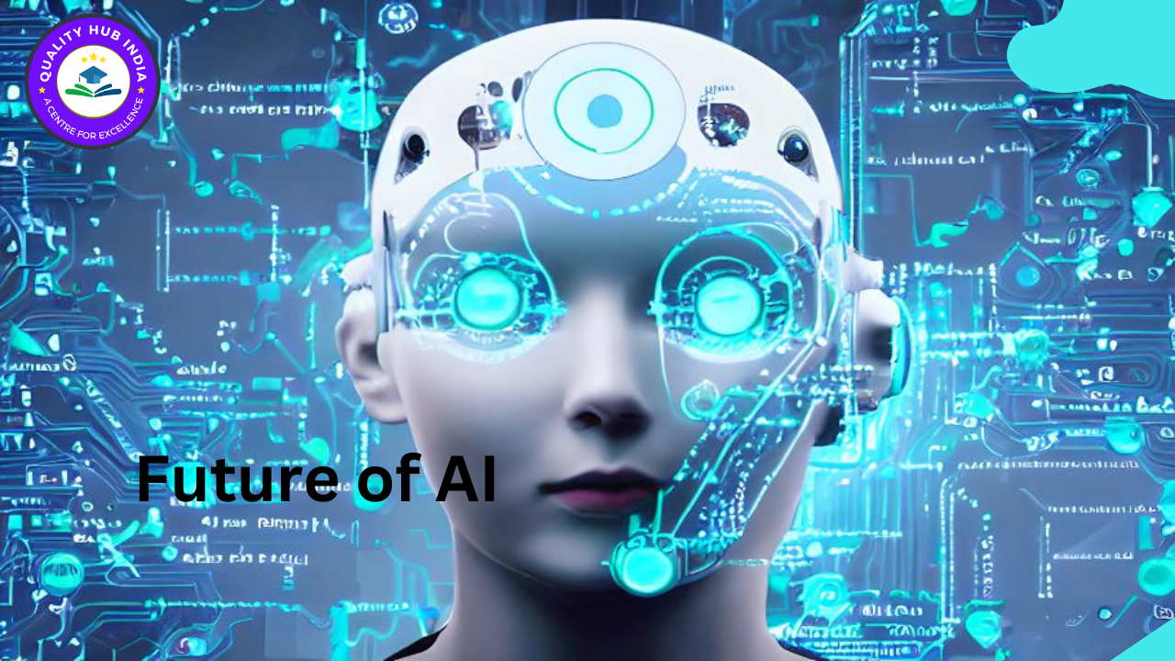
Future of AI
Currently Evolving (2020-2025)
Large Language Models - GPT, Claude, LLaMA and others revolutionizing text generation and understanding
Multimodal AI - Systems that can process text, images, audio, and video together
Foundation Models - Massive pre-trained systems adapted to various downstream tasks
AI-Assisted Coding - Systems that can generate and complete code
Explainable AI - Technologies making black-box AI systems more transparent
Federated Learning - Training models across multiple devices while preserving privacy
AI for Scientific Discovery - Models for protein folding, drug discovery, materials science
Generative AI - Image, audio, and video generation from text prompts
Small Language Models - Efficient models that can run on edge devices
Neural Radiance Fields (NeRF) - 3D scene reconstruction from 2D images
Notes:
Image source: https://qualityhubindia.com/future-of-ai-artificial-intelligence-potential-impacts-industries-healthcare/

Slide 37
Future of AI
Near Future (2025-2030)
Autonomous AI Agents - Systems that can plan and execute complex tasks with minimal supervision
AI-Human Collaboration Tools - Interfaces designed for seamless human-AI teamwork
General Purpose Robotics - Robots that can learn and adapt to varied physical tasks
Neuromorphic Computing - Hardware designed to mimic neural structures for efficiency
Quantum Machine Learning - AI algorithms leveraging quantum computing advantages
Adaptive AI Systems - Models that continuously learn and adapt to changing environments
Advanced AI Planning and Reasoning - Systems with improved causal reasoning capabilities
AI Diplomacy and Negotiation - Models that can represent interests and find compromises
Embodied AI - Systems with improved understanding of physical world interaction
Synthetic Data Generation - Creating realistic training data to overcome privacy and scarcity issues
Notes:
Image source: https://qualityhubindia.com/future-of-ai-artificial-intelligence-potential-impacts-industries-healthcare/

Slide 38
Future of AI
Further Horizon (2030+)
General AI Assistants - Systems approaching human-level assistance across domains
Brain-Computer Interfaces with AI - Direct neural connections enhanced by AI processing
Self-Designing AI Systems - AI that can improve its own architecture
Artificial General Intelligence Components - Building blocks for more general capabilities
AI for Climate Modeling and Intervention - Systems to address climate challenges
Personalized Education AI - Truly adaptive learning experiences
Collective Intelligence Systems - Frameworks integrating human and AI capabilities at scale
AI in Space Exploration - Autonomous systems for extraterrestrial exploration
Quantum-Enhanced General AI - Systems leveraging quantum processing for reasoning
Global AI Governance Systems - International frameworks for AI development and deployment
Notes:
Image source: https://qualityhubindia.com/future-of-ai-artificial-intelligence-potential-impacts-industries-healthcare/

Slide 39
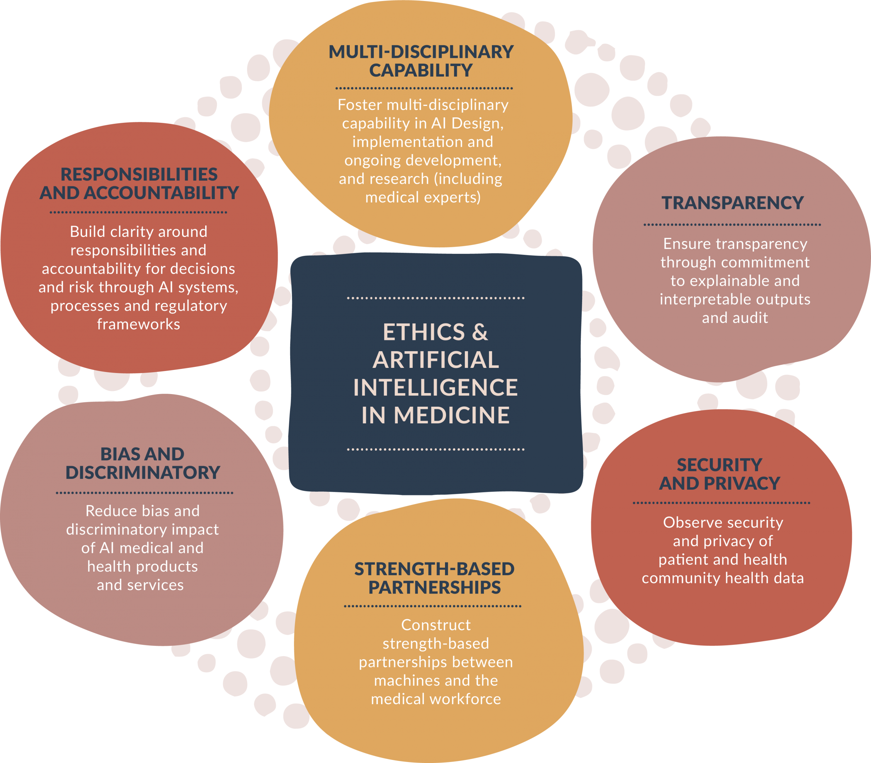
Conclusion
Understanding the fundamentals of AI is essential for navigating its impact on society.
As AI technologies continue to evolve, staying informed about their capabilities and limitations is crucial.
Embracing responsible AI development will help harness its benefits while mitigating risks.
Notes:
Image source: https://mavink.com/explore/Diagram-of-Ai

Slide 40
Q & A /Feedback

